Slide 1
WIX1002 Fundamentals of Programming
Dr. Unaizah Obaidellah – UO (unaizah@um.edu.my) - Coordinator
Prof Dr Nor Badrul Anuar Juma’at - NBA (badrul@um.edu.my)
AP Dr Nizam Ayub – MNA (nizam_ayub@um.edu.my)
Dr Hazim Hanif – HZM (hazimhanif@um.edu.my)
Dr Uzair Istihaq – UZI (uzair@um.edu.my)
Dr Adeleh Asemi Zavareh – AD (adeleh@um.edu.my)
Dr Burhan Khan – BIK (burhankhan@um.edu.my)
Dr Rasha Ragheb Attaallah – RRA (rashaatallah@um.edu.my)
Dr Nurul Japar – NJ (nuruljapar@um.edu.my)
Dr Muhammad Faiz Mohd Zaki – MFZ (faizzaki@um.edu.my)

Slide 2
Learning Outcomes
At the end of the course, the student is able to:
Define the steps of problem solving in programming.
Rewrite programs that contain errors.
Develop programs based on principles of object-oriented.

Slide 3
Syllabus
Week 1 - Problem Solving in Programming
Week 2 - Java Fundamental
Week 3 - Flow of Control (Selection)
Week 4 - Flow of Control (Repetition I)
Week 5 - Flow of Control (Repetition II)
Week 6 - Array
Week 7 - Java Methods

Slide 4
Syllabus
Week 8 - Revision + Mid Semester Test
Week 9 - File Input and Output
Week 10 - Class
Week 11 - Inheritance
Week 12 - Polymorphism
Week 13 - Exception Handling
Week 14 – Group Presentation

Slide 5
References
Book
Y. Daniel Liang, 2020, Introduction to Java Programming and Data Structures, Comprehensive Version, 12th Edition, Pearson. ISBN-10: 0136520235.
Herbert Schildt, 2018, Java: A Beginner's Guide, 8th Edition, McGraw-Hill Education, ISBN-10: 1260440214.
Joshua Bloch, 2017, Effective Java, 3rd Edition, Addison-Wesley Professional. ISBN-10: 0134685997.
Online Tutorial
Java
http://docs.oracle.com/javase/tutorial
Apache NetBeans
http://netbeans.apache.org/kb/docs/java

Slide 6
References
UM eLearning
http://spectrum.um.edu.my/
Tools
Java SE Development Kit
https://www.oracle.com/java/technologies/javase-downloads.html
Select JDK download - Select the installer based on your OS type (windows, linux, macos)
Apache NetBeans 12.5
https://netbeans.apache.org/download/nb125/nb125.html
Select the installer based on your OS type (windows, linux, macos).
Install JDK first before Apache NetBeans

Slide 7
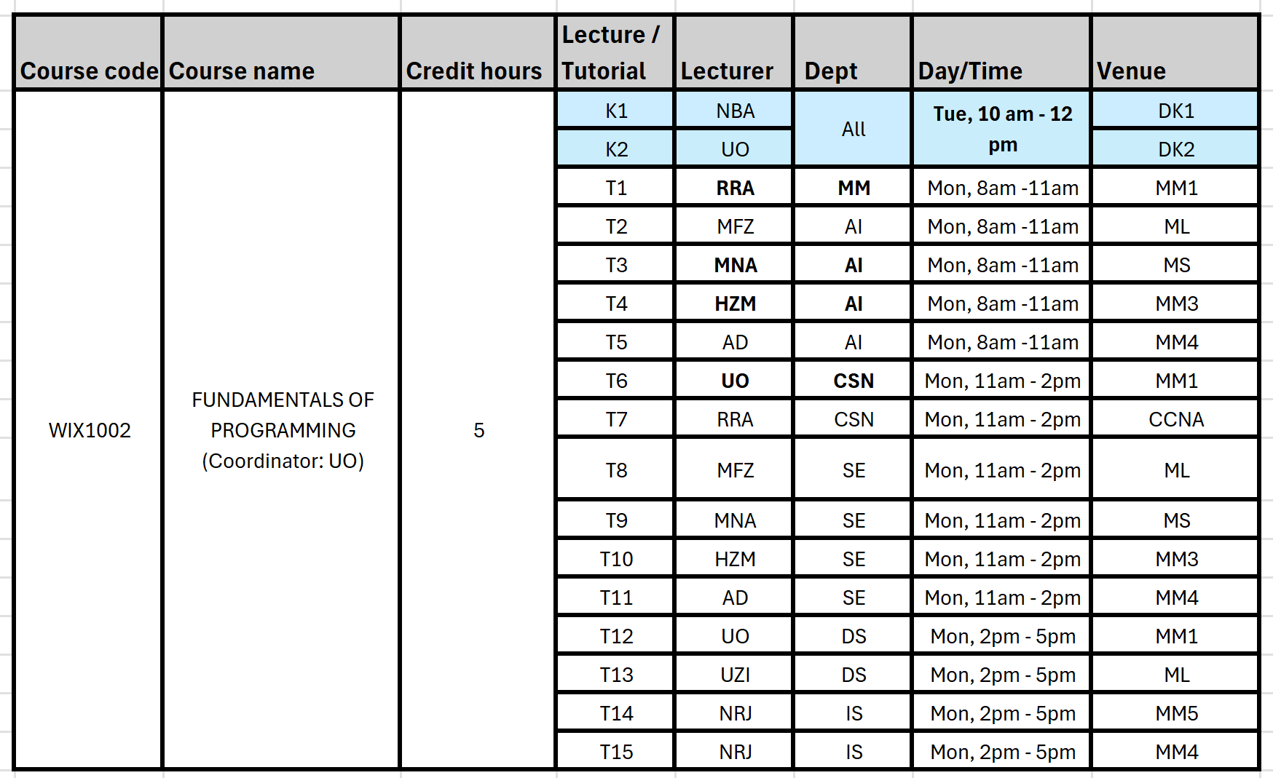
Time Table

Slide 8
Assessments
Continuous Assessment
Mid Semester Test 20% (Week 8)
09 December 2025 (Tuesday during Lecture)
Lab (3x) (Group) 15%
Presentation and Submission Due (Week 6, Week 9, Week 12)
Assignment (Group) 15%
Submission Due (Week 13 – Fri, 16/01/2025, 2359pm)
Assignment Presentation (Week 14)

Slide 9
Assessments
Final Exam (50%)
Date: TBA
Venue: TBA

Slide 10
Tips
Understand the concepts well.
Refer to programming examples.
Do more practice
Get a programming book.
Complete all the tutorials and lab exercises by yourself.

Slide 11


